Slide 1
Memory Management
Dr. Manmath N. Sahoo
Dept. of CSE, NIT Rourkela

Slide 2
OS and User Area
OS
USER Processes
USER Processes
OS
or

Slide 3
Protection of OS area from users
3 Schemes
Automatic address translation
Page-0 and Page-1 addressing
Limit register

Slide 4
Automatic address translation
OS
USER Processes
0000
Problem: Loading non-residence part of OS
3999
0000
4000
CPU address
Actual address
+4000
11999
15999
User View
System View

Slide 5
Page-0 and Page-1 addressing
OS
USER Processes
00000000000000
8K
01111111111111
10000000000000
8K
11111111111111
Problems:
Loading non-residence part of OS, may exceed page-0
If OS is small then memory wastage

Slide 6
Limit Register
Limit register stores the size of the OS
OS
USER Processes
0000
LimitReg=4000
3999
0000
4000
CPU address
Actual address
+LimitReg
11999
15999

Slide 7
Interprocess protection
OS
P1
P2
P3
0000
Suppose P2 is running
Base=5000 //base address of P2
Limit=2000 //size of P2
3999
0000
4000
0999
4999
0000
5000
1999
6999
0000
7000
0999
7999

Slide 8
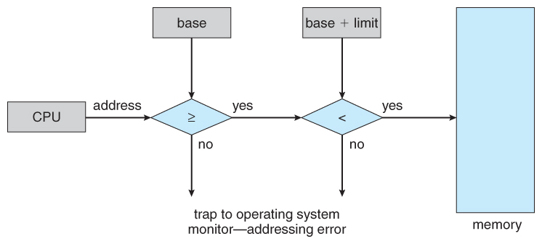
Interprocess protection
CPU address
actual
MMU

Slide 9
Logical address space vs Physical address space
CPU generates logical/virtual addresses for instructions and data
Logical addresses are converted/mapped to physical addresses by Memory Management Unit (MMU) – hardware unit.

Slide 10
Memory allocation schemes
Contiguous
Each process allocated a single contiguous chunk of memory
Fixed equal-size partitions
Fixed unequal-size partitions
Dynamic partitioning
Noncontiguous
Parts of a process can be allocated non-contiguous chunks of memory

Slide 11
Fixed equal-size partitions
If there is an available partition, a process can be loaded into that partition
because all partitions are of equal size, it does not matter which partition is used.
0
1
2
MFT
3
MAT
Partition# | Process#
Partition# | Availability
0 | 0
1 | 1
2 | 1
3 | 1
4 | 1
5 | 1
6 | 1
7 | 1
4
5
6
7

Slide 12
Fixed equal-size partitions
0
MAT
MFT
P1
1
Partition# | Process#
1 | P1
2 | P2
3 | P3
Partition# | Availability
0 | 0
1 | 0
2 | 0
3 | 0
4 | 1
5 | 1
6 | 1
7 | 1
P2
2
P3
3
4
5
6
7

Slide 13
Fixed Unequal-size partitions
MAT
MFT
Partition# | Process#
Partition# | Availability
0 | 0
1 | 1
2 | 1
3 | 1
4 | 1
5 | 1
6 | 1
7 | 1

Slide 14
Placement Algorithm with Unequal-size Partitions
Unequal-size partitions, use of multiple queues:
a queue exists for each partition size.
assign each process to the smallest partition within which it will fit.
tries to minimize internal fragmentation.
problem: some queues might be empty while some might be loaded. – decreases degree of multiprogramming

Slide 15
Placement Algorithm with Unequal-size Partitions
Unequal-size partitions, use of a single queue:
the smallest available partition that will hold the process is selected.
increases the level of multiprogramming at the expense of internal fragmentation.

Slide 16
Dynamic partitioning
In fixed partitioning, degree of multiprogramming limited by number of partitions.
Hole – block of available memory; holes of various size are scattered throughout memory.
When a process arrives, it is allocated memory from a hole large enough to accommodate it.
Process exiting frees its partition, adjacent free partitions combined.

Slide 17
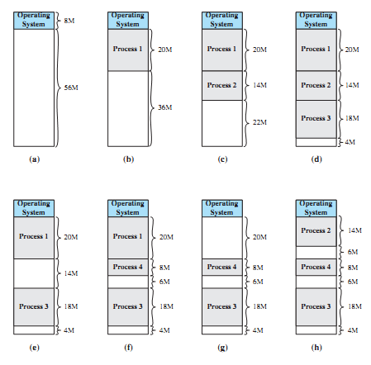
Dynamic partitioning

Slide 18
Dynamic partitioning
MAT
MFT
Process | Starting address | Displacement
Starting address | Displacement
8000 | 63999
External fragmentation

Slide 19
Placement Algorithms in Dynamic partitioning
To satisfy request of size n from list of free holes – four basic methods:
First-fit: Allocate the first hole that is big enough.
Next-fit: Same logic as first-fit but starts search always from the last allocated hole (need to keep a pointer to this) in a wraparound fashion.
Best-fit: Allocate the smallest hole that is big enough; must search entire list, unless ordered by size. Produces the smallest leftover hole.
Worst-fit: Allocate the largest hole; must also search entire list. Produces the largest leftover hole.

Slide 20
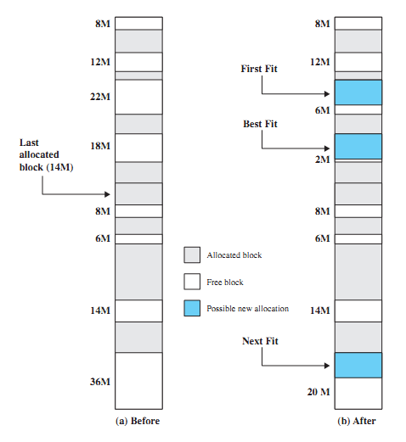
Placement Algorithms in Dynamic partitioning
New process of 16MB.

Slide 21
Paging (Noncontiguous allocation)
Physical memory is divided up into fixed-sized blocks called frames.
Logical memory of a process is also divided into blocks of same size as the page frames. These blocks called pages.
OS keeps track of all free frames.
To run a program of size n pages, need to find n free frames and load program into them.
Then set up a page table to translate logical to physical addresses. Separate page table for each process.

Slide 22
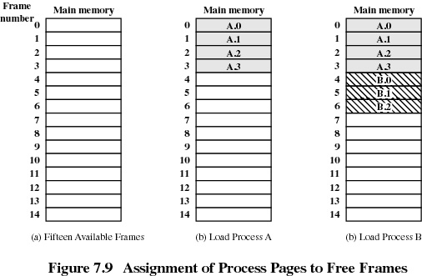
Paging

Slide 23
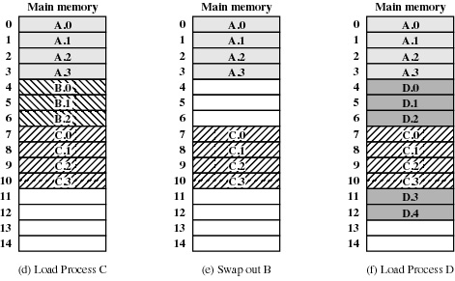
Paging

Slide 24
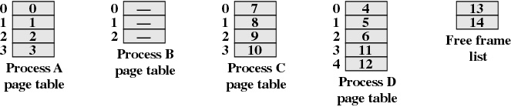
Page Tables for Example

Slide 25
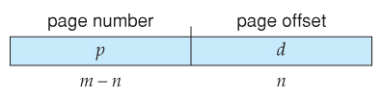
Address Translation Scheme: Paging
Address generated by CPU is divided into:
Page number (p) – used as an index into a page table which contains base address of each page in physical memory.
Page offset (d) – combined with base address to define the physical memory address that is sent to the memory unit.
Logical address space is 2^{m}, and frame size is 2^{n}.
Higher order (m-n) bits are used for page number (p) and lower order n bits are used for page offset (d)

Slide 26
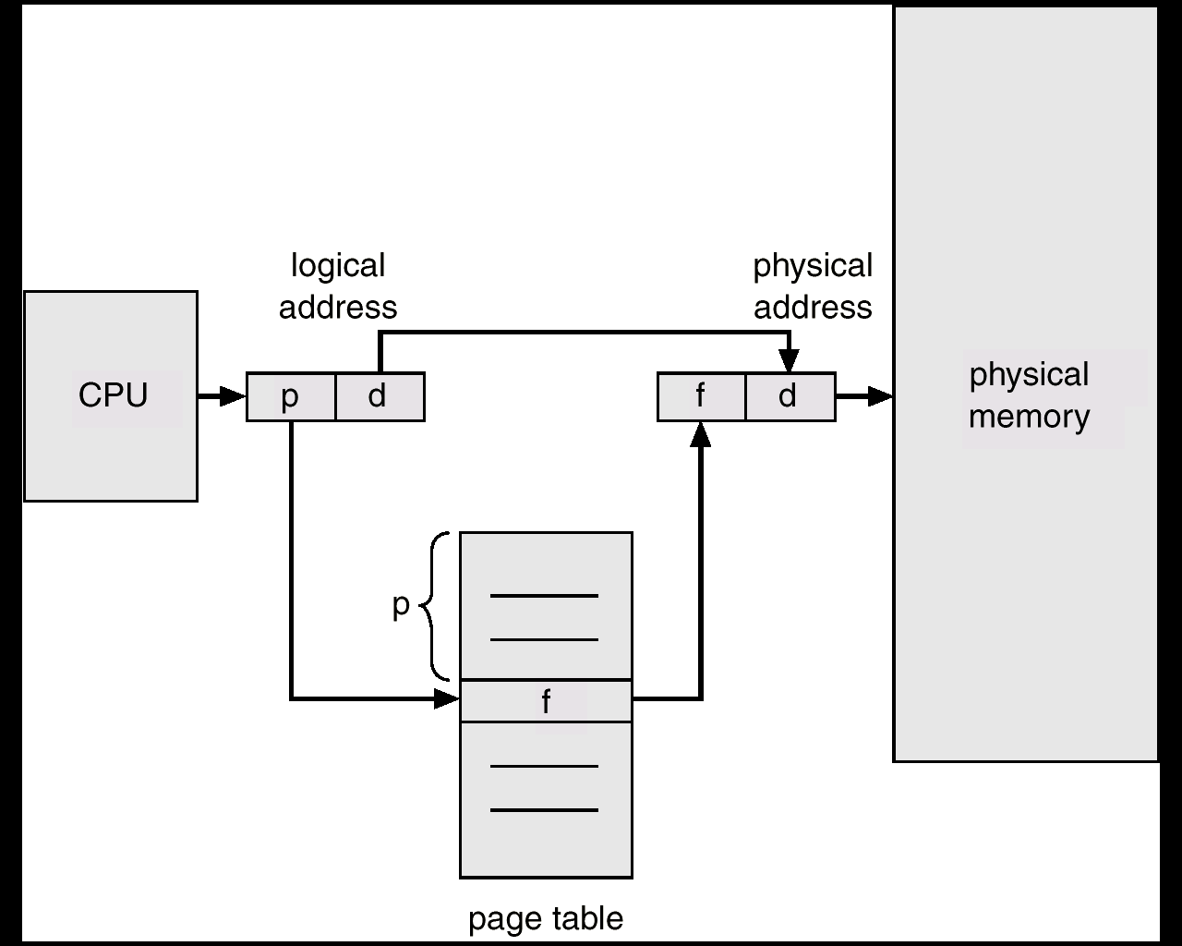
Address Translation Scheme: Paging

Slide 27
Implementation of Page Table
Set of dedicated registers:
Let 16-bit logical address, and page size=8K.
Page table contains maximum 8 entries.
8 dedicated registers can store the page-frame mappings.
Not practical if page table contains large number of entries.

Slide 28
Implementation of Page Table
PMT kept in main memory.
Page Table Base Register (PTBR) points to the PMT.
Page Table Length Register (PTLR) stores size of the PMT.
Memory access is slowed down by a factor of 2.

Slide 29
Implementation of Page Table
PMT kept in main memory and TLB
A small, high speed associative cache called Translation Look-aside Buffer (TLB) stores some entries of PMT.
PMT, as a whole is stored on main memory.
TLB (Associative Cache) – allow parallel search
Page# | Frame#

Slide 30
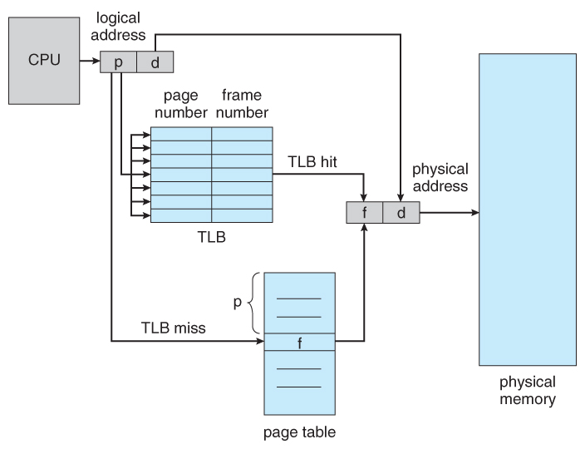
TLB hardware for paging

Slide 31
Effective memory access time
Memory access time = 100ns
TLB lookup time = 20ns
TLB hit ratio = 80%
Effective access time =
0.8 * (20+100) + 0.2 * (20+2*100) = 140 ns

Slide 32
Shared Pages
If the code is reentrant (not self-modifying) then it can be shared among processes.
Let 40 users executing text editor
Text editor: 150KB code + 50KB data
Total memory required = 8000KB (more)
However, code pages can be shared
Let page size = 50KB then 3 code pages and 1 data page per user

Slide 33
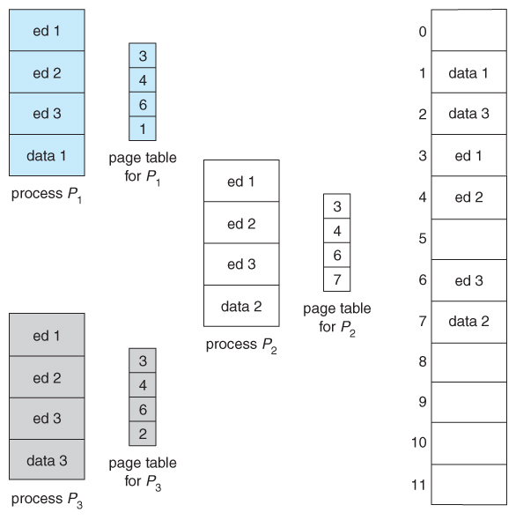
Shared Pages
150KB shared code + 40*50KB data
=2150KB (40 users)

Slide 34
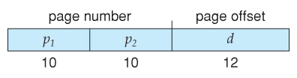
Page Table Structure
Most modern computer systems support 32bit or 64bit logical address.
Consider a system with 32bit logical address, and page size of 4K
# of entries in PMT=2²⁰ (worst case)
Each entry of PMT stores a 21bit frame# and other attributes (for a 8GB memory).
If each entry is of 4bytes then memory required by PMT=4*2²⁰=4MB (large)
Do we need to apply paging on the PMT itself??
YES – Hierarchical Paging
20
12

Slide 35
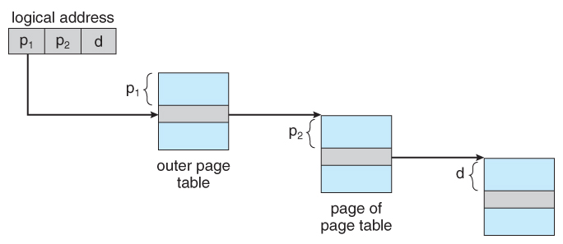
2-level paging example Page size=3K, each entry in PMT=1K
Inner Page Table
Process A=18K
0
1
2
3
4
5
3
1
7
8
5
6
pg0
Main memory
0
1
2
3
4
5
0
1
2
3
4
5
6
7
8
9
10
11
12
13
14
A.1
A.0
A.4
A.5
A.2
A.3
pg1
pg0
Outer Page Table
pg0
pg1
2
11
1
1
9
2
pg1
11
8
5
6
5
9

Slide 36
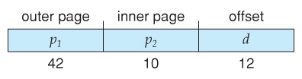
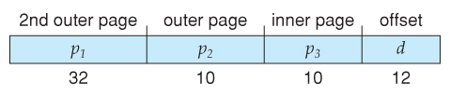
Hierarchical paging
For a 64-bit logical address system:
64-bits Two-level leaves 42 bits in outer table
Going to a fourth level still leaves 32 bits in the outer table.
5th
4th
3rd
2
10
10
10
7 levels of indirection, which would be prohibitively slow memory access

Slide 37
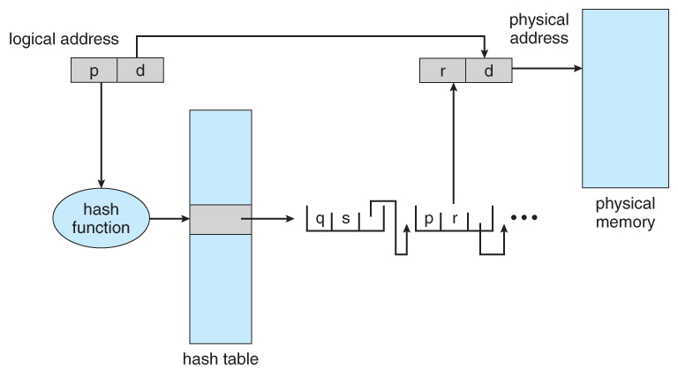
Hashed Page Tables

Slide 38
Inverted Page Table
Managing per-process PMT is complex.
Inverted page table keeps an entry corresponding to each physical frame
Inverted PMT
Main memory
A
B
C
0
0
0
0
B
0
0
B.0
1
1
1
1
A
0
1
A.0
2
2
A
1
2
A.1
3
B
1
3
B.1
4
C
0
4
C.0
5
A
2
5
A.2
6
C
1
6
C.1
7
7

Slide 39
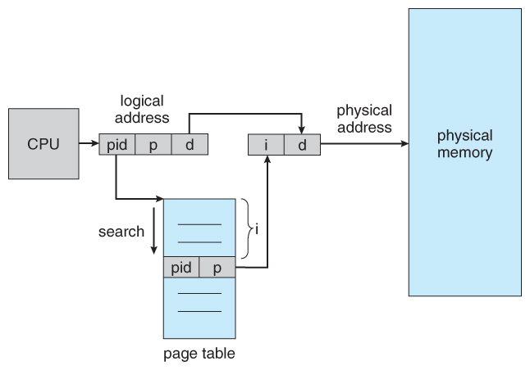
Inverted Page Table
Logical Address
Physical Address
B
1
9
3 | 9
1
9

Slide 40
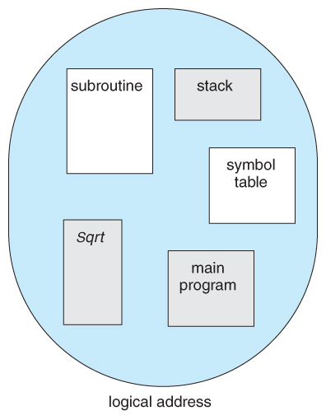
Segmentation
User view (at higher level of abstraction) - Process as a collection of blocks (segments)
E.g., main(), sqrt(), stack etc

Slide 41
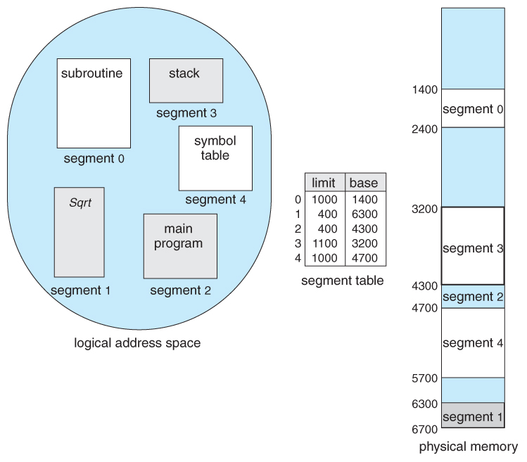
Segmentation Example

Slide 42
Segmentation Hardware
Logical address consists of a pair: <segment-number, offset>,
Segment number is an index into the segment table - with one segment table for each process
offset is the value to be added to start address of segment to give real physical address
each entry in segment table has:
base value – contains the starting physical address where the segment resides in memory.
limit – specifies the length of the segment.
Offset address is legal if offset < limit value

Slide 43
Segmentation Hardware
Segment-table base register (STBR) points to the segment table’s location in memory.
Segment-table length register (STLR) indicates number of segments used by a process;
segment number s is legal if s < STLR.

Slide 44
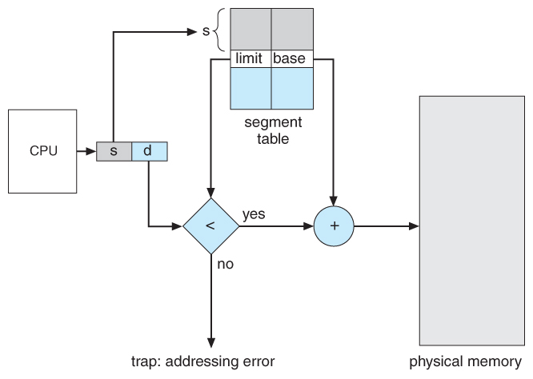
Segmentation Hardware

Slide 45
Segmentation with Paging
Logical Address
Segment# | Page# | Offset
PMT-0
Segment Table
Segment# | Page Table Base
0
1
2
3
PMT-1
PMT-2
PMT-3

Slide 46
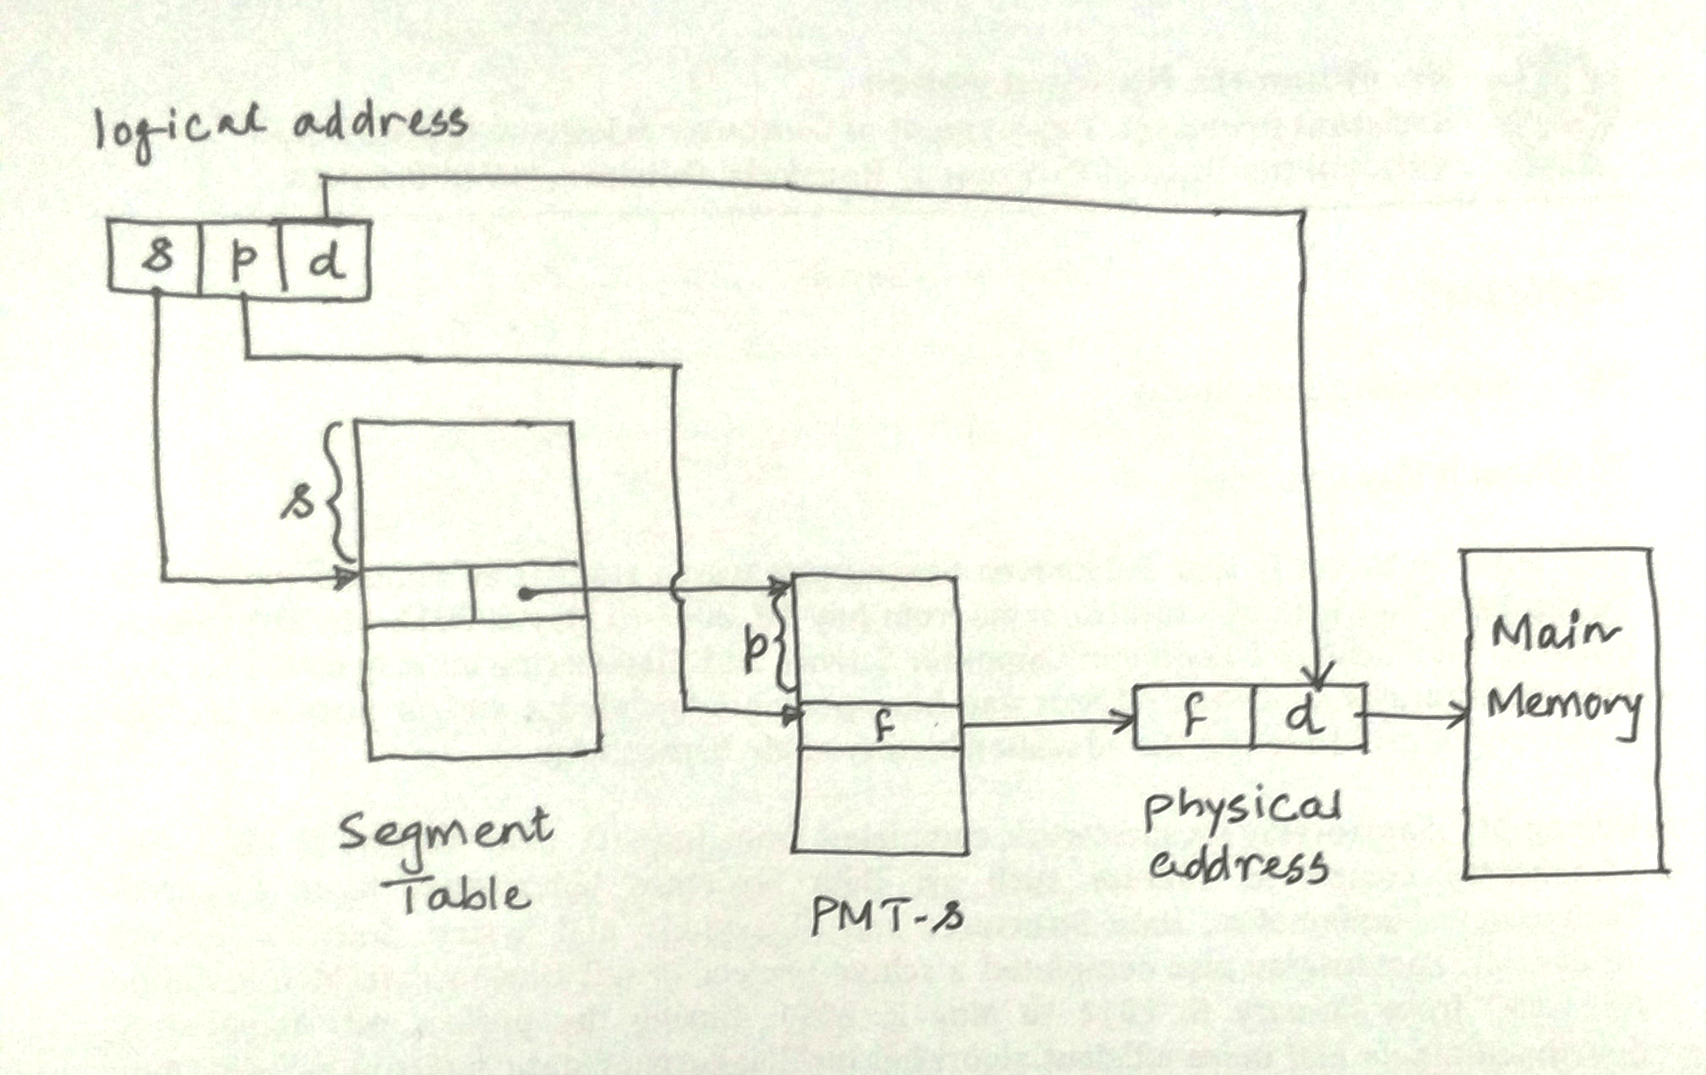
Segmentation with Paging: Address Translation

